Slide 1

Demand Paging, Page Replacement Algorithms, Allocation of Frames

Slide 2
Background
Goal of Memory Management:
Instructions being executed must be in physical memory.
Review of Chapter # 9:
Fitting all program (as a results of Multitasking) into the physical memory is a challenge.
Continuous allocation of Memory -> Dynamic allocation problem (First-fit, Best-fit, Worst-fit) -> Fragmentation (External + Internal)
Solution to fragmentation -> #1: Compaction #2: Paging
Paging permits a process’s physical address space to be noncontiguous. It avoids external fragmentation and the associated need for compaction.

Slide 3
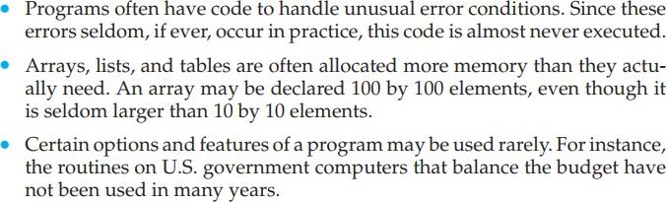
Do we need the entire program in memory?

Slide 4
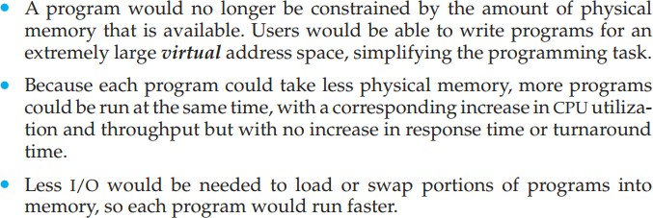
Benefits in program execution that is only partially in memory
Thus, running a program that is not entirely in memory would benefit both the system and its users.

Slide 5
Virtual Memory
Virtual memory is a computer memory management technique that allows a computer to use more memory than physically available by temporarily transferring data from RAM to hard disk storage.
Major advantage:
Programs can be larger than physical memory.
It provides an efficient mechanism for process creation.
May substantially decrease performance if it is used carelessly. Chapter # 10 examines how it is implemented, and explore its complexity and benefits.

Slide 6
Virtual Memory Vs Paging
Virtual memory and paging are closely related concepts, but they are not exactly the same.
Virtual memory refers to the technique of using disk storage to simulate additional RAM, while
Paging specifically refers to the process of transferring memory pages between RAM and disk storage. Paging is one aspect of virtual memory
Virtual memory covers a broader set of techniques that collectively enable the efficient use of memory resources in a computer system, such as
demand paging
page fault handling, and
memory allocation strategies

Slide 7
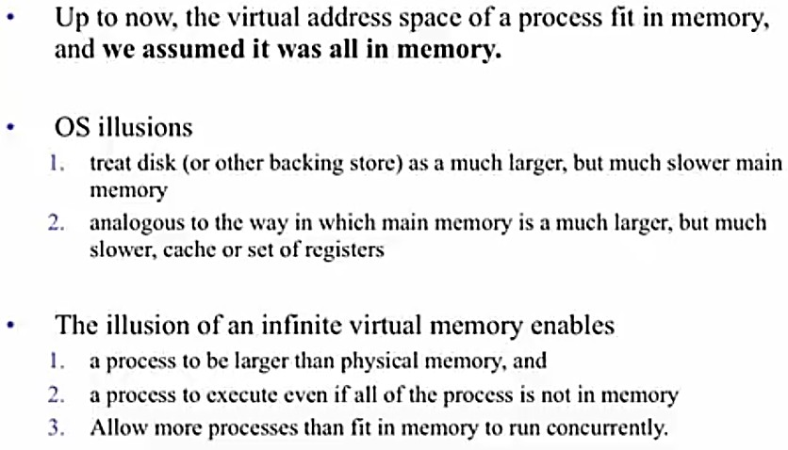
Demand Paging Paged Virtual Memory

Slide 8
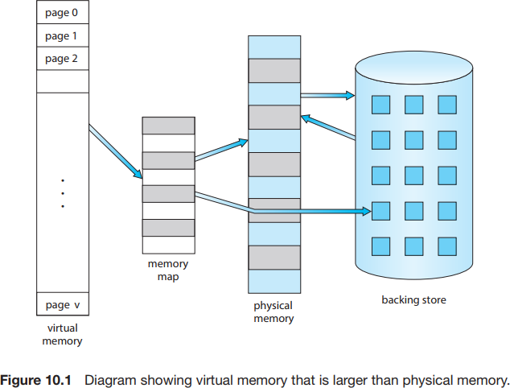
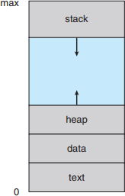
Logical or Virtual Address Space
The large blank space (or hole) between the heap and the stack is part of the virtual address space but will require actual physical pages only if the heap or stack grows. Virtual address spaces that include holes are known as sparse address spaces.

Slide 9
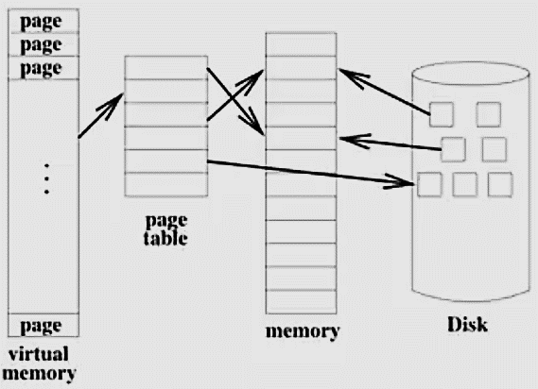
Page Fault
Page faults are expensive because they involve a time-consuming process of loading data from disk into physical memory. This requires disk I/O operations, which are slow compared to memory access times. Additionally, page faults can cause the operating system to stall the execution of a program until the required page is loaded, resulting in performance degradation.

Slide 10
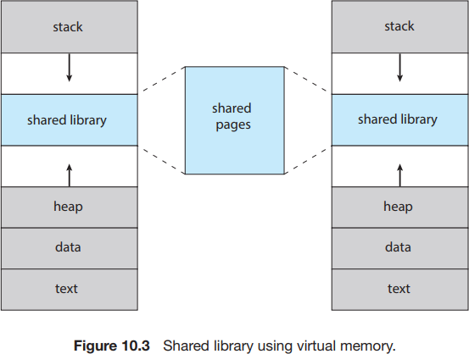
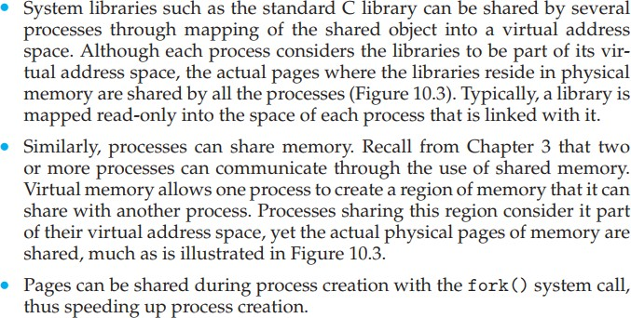
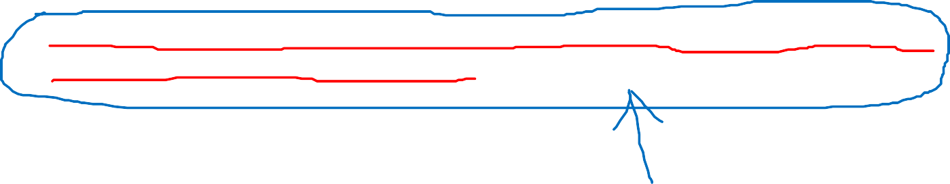
Virtual memory allows files and memory to be shared by two or more processes through page sharing (Section 9.3.4). This leads to the following benefits:

Slide 11
Scenario. Suppose a program starts with a list of available options from which the user is to select. Loading the entire program into memory results in loading the executable code for all options, regardless of whether or not an option is ultimately selected by the user.
An alternative strategy is to load pages only as they are needed. This technique is known as demand paging and is commonly used in virtual memory systems.
With demand-paged virtual memory, pages are loaded only when they are demanded during program execution. Pages that are never accessed are thus never loaded into physical memory.
A demand-paging system is similar to a paging system with swapping (Section 9.5.2) where processes reside in secondary memory (usually an HDD or NVM device).

Slide 12
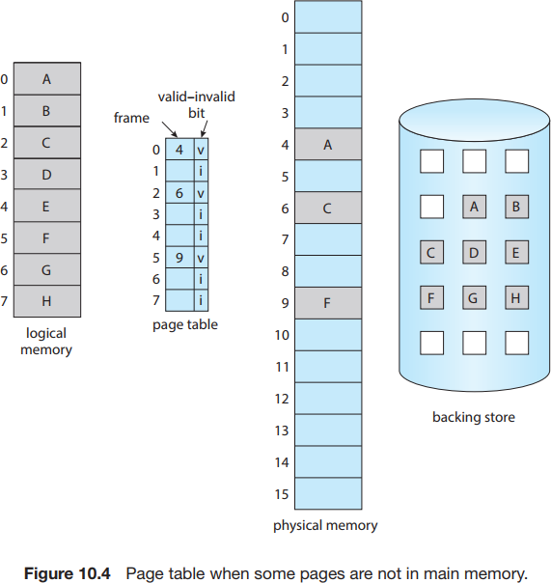

The valid– invalid bit scheme described in Section 9.3.3 can be used for pages not in memory.
When the bit is set to “valid,” the associated page is both legal and in memory.
If the bit is set to “invalid,” the page either is not valid (that is, not in the logical address space of the process) or is valid but is currently in secondary storage.
The page-table entry for a page that is brought into memory is set as usual, but the page-table entry for a page that is not currently in memory is simply marked invalid.
Notice that marking a page invalid will have no effect if the process never attempts to access that page.

Slide 13
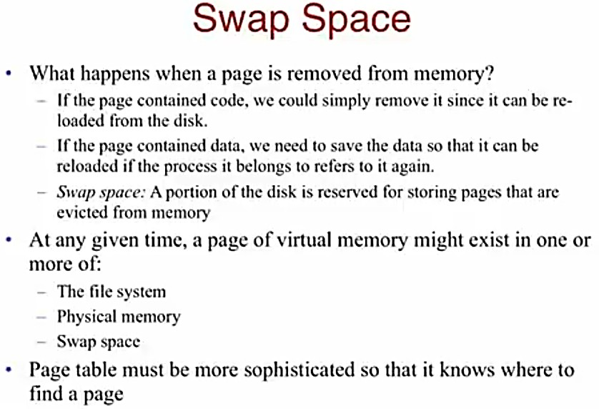
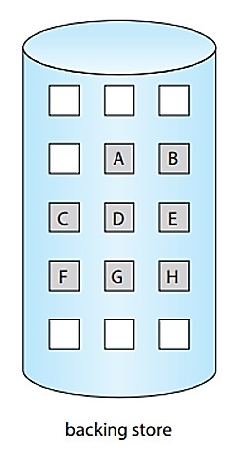

Slide 14
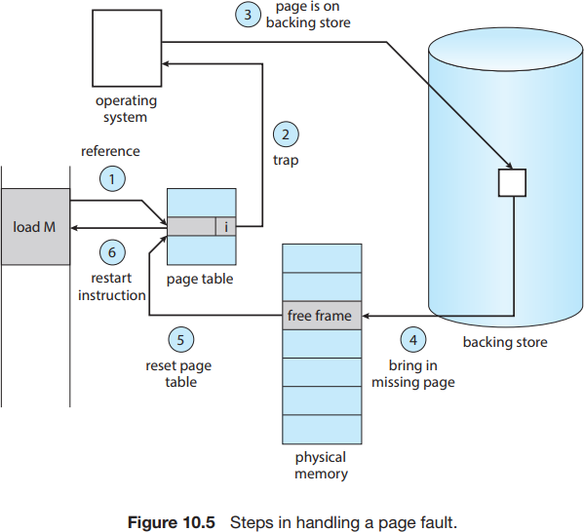
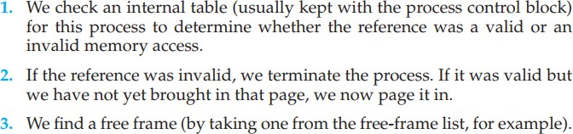
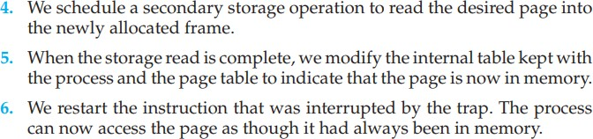
The procedure for handling this page fault is straightforward (Figure 10.5):
Page fault is generated if programs tries to access a page that is not memory (i.e. marks invalid in page table).
The paging hardware, in translating the address through the page table, will notice that the invalid bit is set, causing a trap to the operating system.

Slide 15
Pure demand paging: never bring a page into memory until it is required.
We can start executing a process with no pages in memory. When the operating system sets the instruction pointer to the first instruction of the process, which is on a non-memory-resident page, the process immediately faults for the page. After this page is brought into memory, the process continues to execute, faulting as necessary until every page that it needs is in memory. At that point, it can execute with no more faults.
Programs tend to have locality of reference, described in Section 10.6.1, which results in reasonable performance from demand paging.

Slide 16
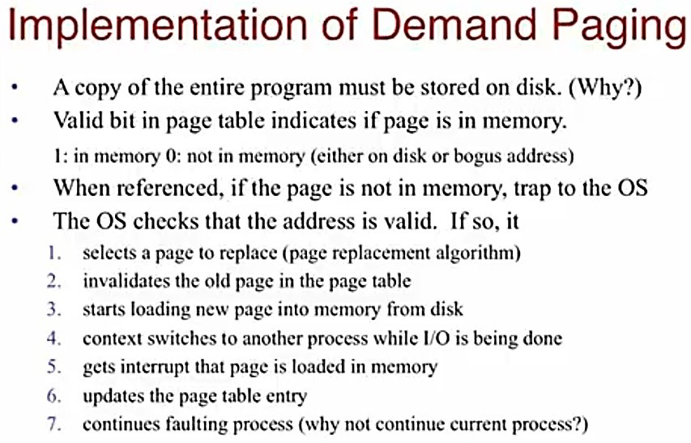

Slide 17
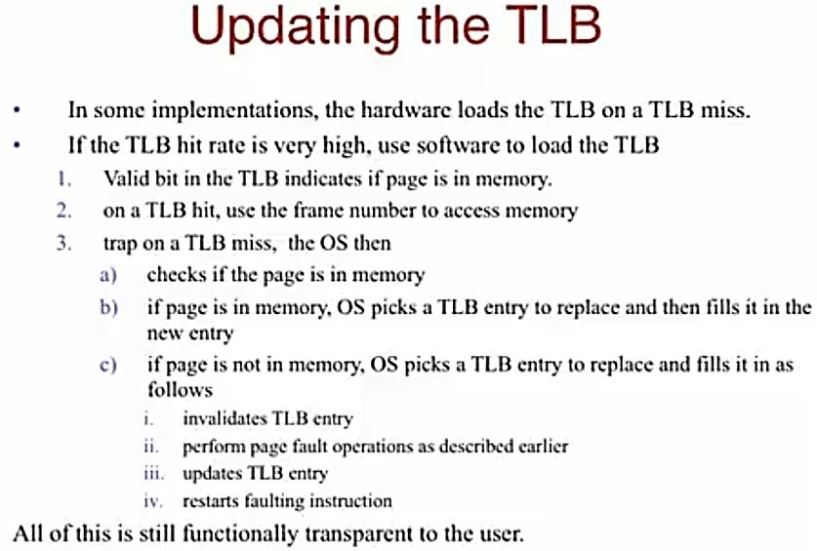

Slide 18
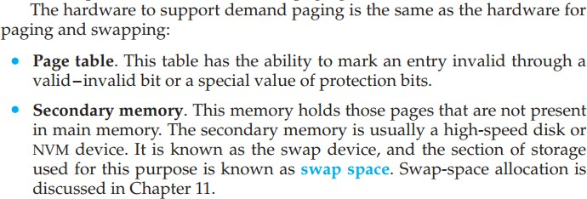

Slide 19








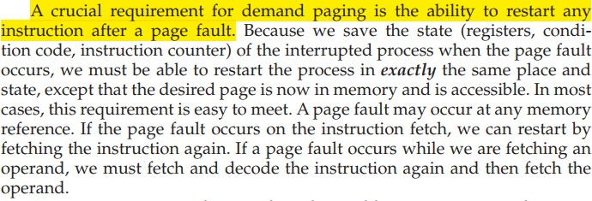
Restarting Instruction which resulted in a page fault

Slide 20
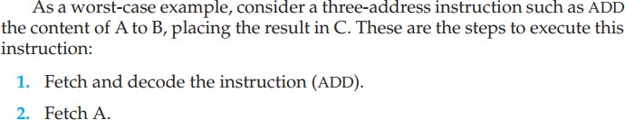
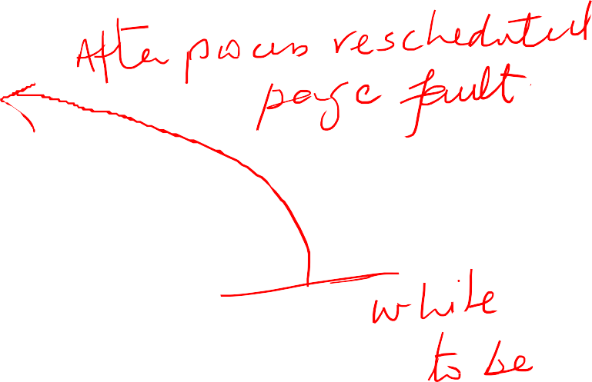

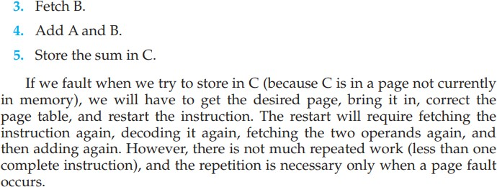




Restarting Instruction which resulted in a page fault

Slide 21
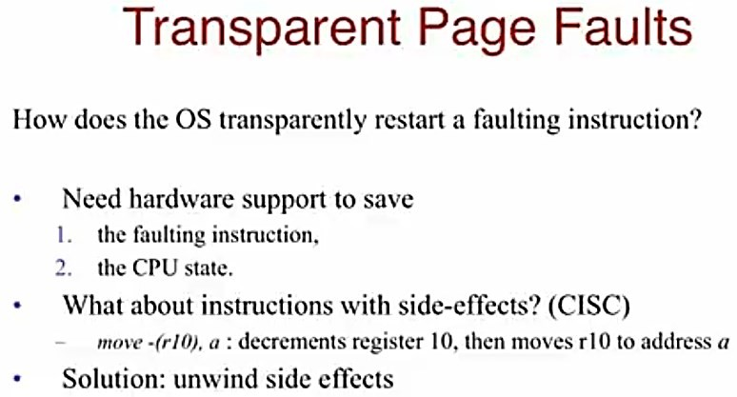
Restarting Instruction which resulted in a page fault

Slide 22
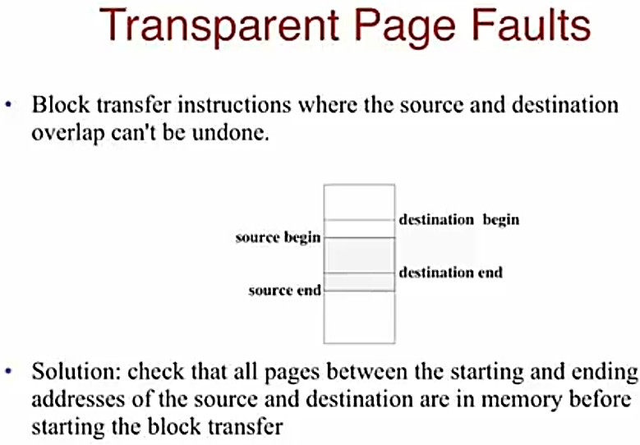
Restarting Instruction which resulted in a page fault

